Slide 1
Final Exam
Speaking practice

Slide 2
Chapter 4
You and your partner take turns talking about what your latest sports competition. Tell them what sport you play, how the game turned out, and how you reacted.
Ask and answer each other’s questions.

Slide 3
Chapter 4
One of you is a doctor and the other is a patient. Tell the doctor you were injured playing soccer and broke your arm, scratched your cheek, and twisted your wrist. The doctor will ask what’s wrong and provide advice.

Slide 4
Chapter 6
You and your friend are discussing your childhoods. Discuss what you liked to do, if you got along well with siblings/friends, and what you wanted to be when you grew up.
Ask and answer each other’s questions to find out all the above information.

Slide 5
Chapter 6
You and your friend are still discussing your childhood but this time find out what each other were like. Also find out what their friends were like. Finally ask your friend to describe an important event during their childhood (in the preterite) and find out how they reacted.

Slide 6
Chapter 7
One of you is a waiter and the other a client. Pretend you are in a restaurant and act out a typical situation. Ask for the menu, recommendations, order food, and ask how it is in general. The waiter should ask for the client’s order, provide recommendations and be polite.

Slide 7
Chapter 7
Find out if your friend eats a balanced diet and why. Also ask what sort of ingredients they typically add to their food. Finally discuss a favorite dish, how to make it, and what’s in it.

Slide 8
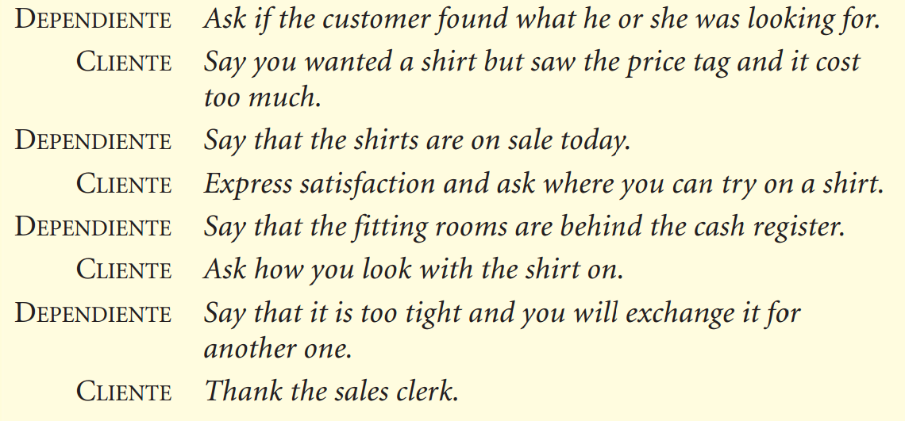
Chapter 8
One of you is the store clerk and the other the client. Act out the following situation.

